Slide 1
Design of Autonomous Food Delivery Vehicle
Kevin Harper , Montraz Oliver , and Eli Nbede

Slide 2
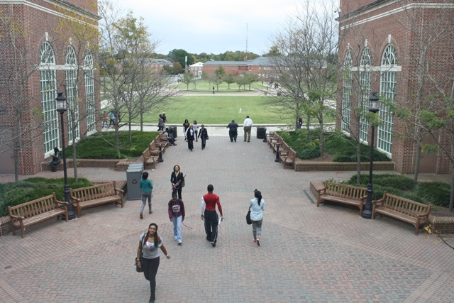
Background
“Among the 214 National Universities that reported these data to U.S. News in an annual survey, the average percentage of students who brought cars to campus in the 2016-2017 academic year was 46.8 percent”

Slide 3
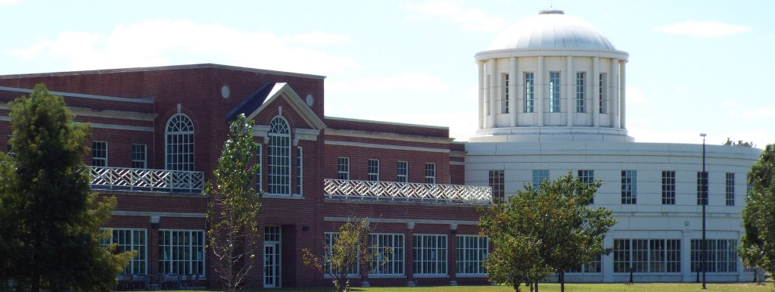
UMES Dining Services
UMES Student Service Center offers Chick-fil-a, Starbucks Proud Brew, and Austin Grill but has no delivery options.

Slide 4
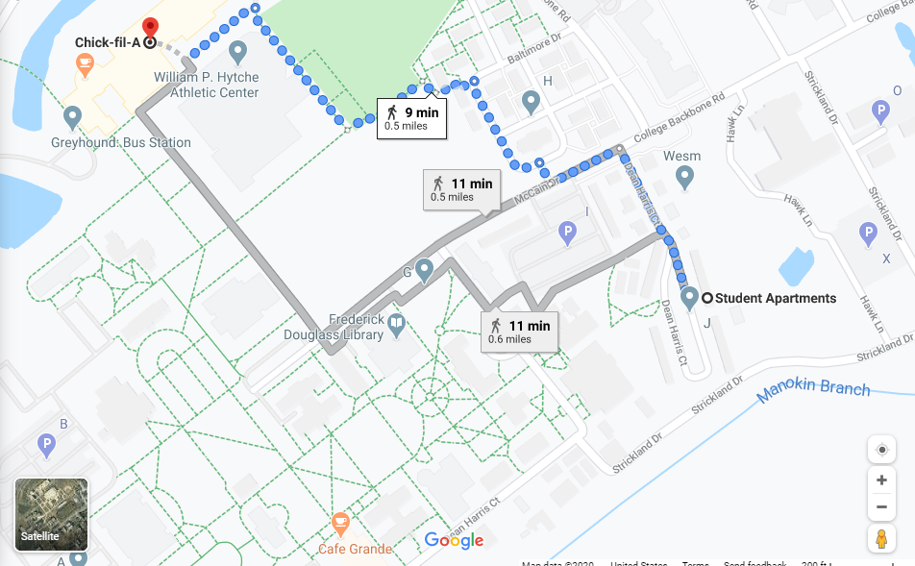
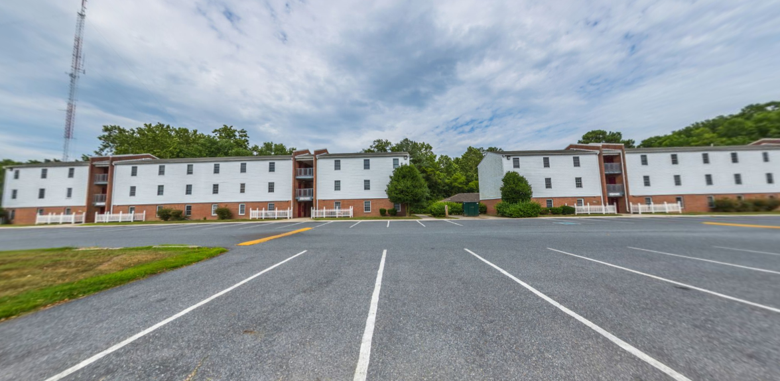
Walking Students
A UMES student living in Students Apartments has to walk 9 - 11 minutes to reach the SSC.

Slide 5
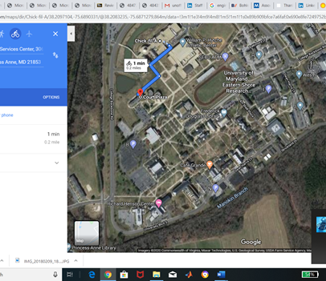
Objective
Design an autonomous electric car that can deliver dining services around campus universities

Slide 6
Design Requirements
Travel distance a total of 2 miles
Carry up to eight pounds of food
Will deliver one meal at a time
Open and close food compartment
Tracking
Speed of 5-10 mph
Food compartment
Drive on the sidewalk
Detect roadways and moving objects
Maneuver stationary and moving objects
Application interface with the electric car
Navigation

Slide 7
Design Constraints
Tires might not be able to withstand certain road conditions
Driving in rough weather conditions
Going up stairs or ramps
Driving on the roadway

Slide 8
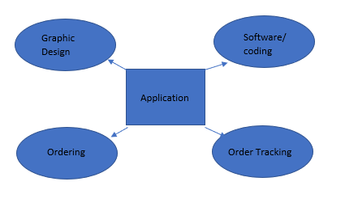
System Diagram

Slide 9
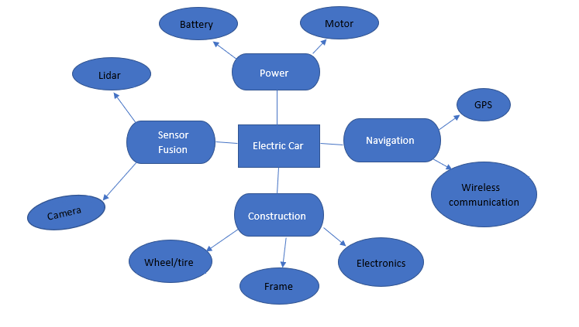
System Diagram

Slide 10
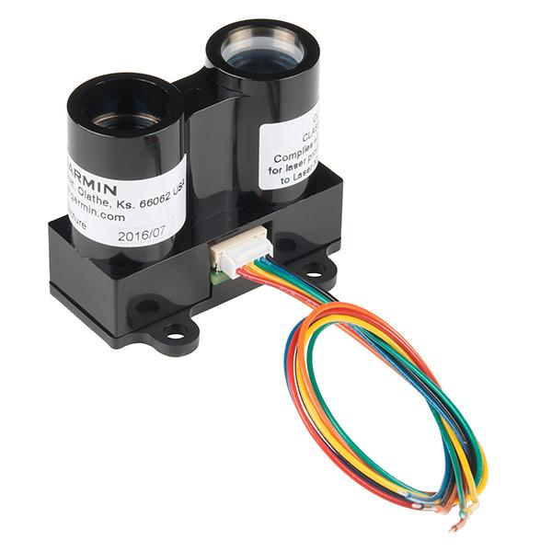
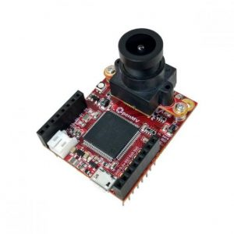
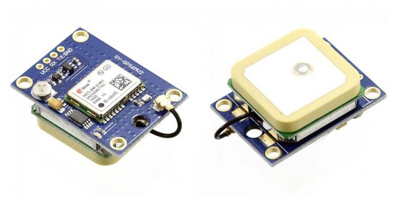
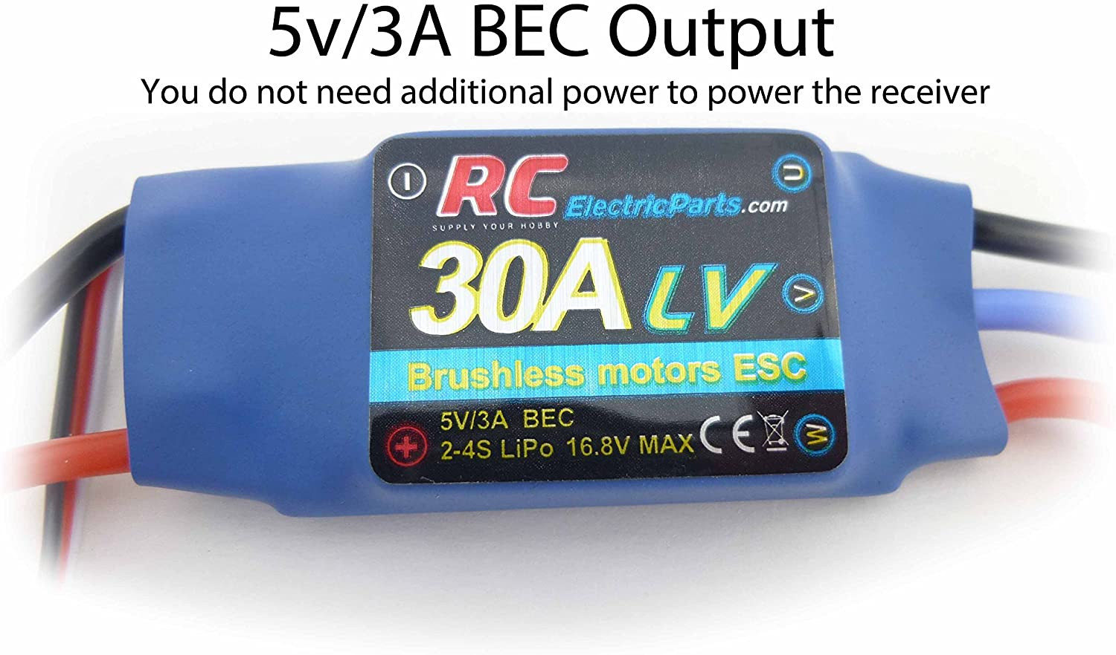
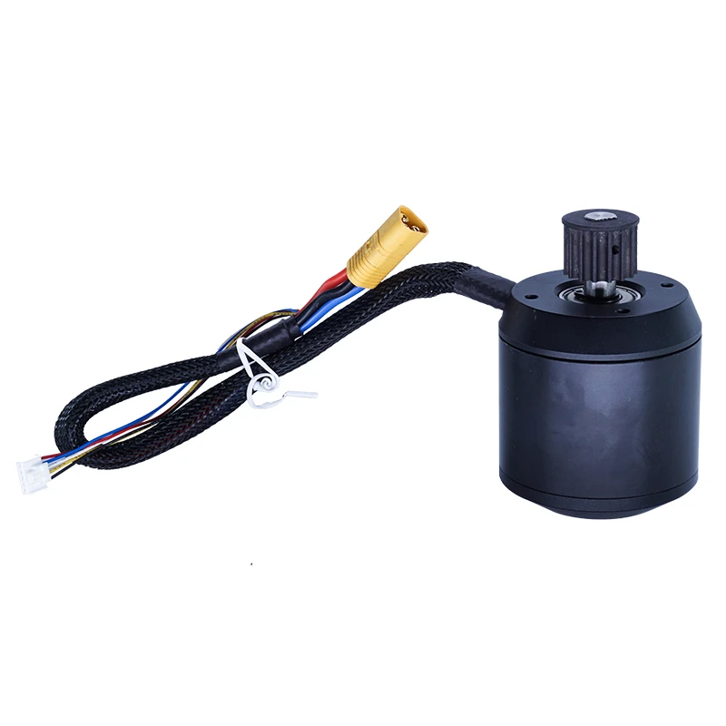
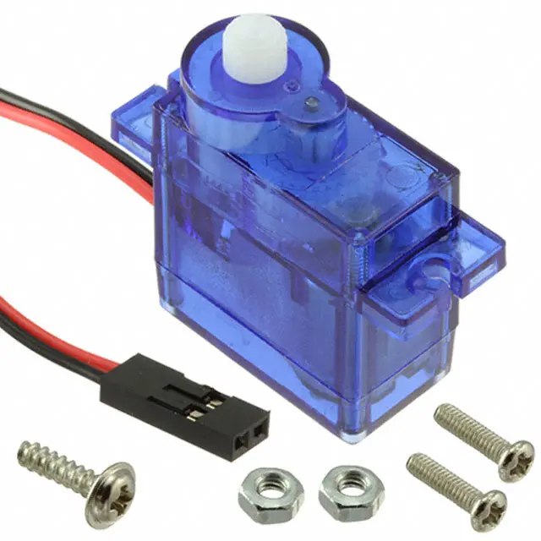
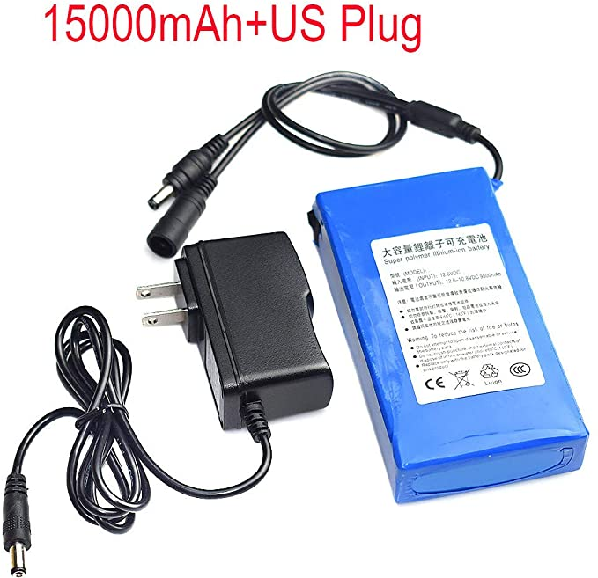
System Description
Lidar-Lite V3
$129.99
OpenMV H7 Cam
$65.00
NEO 6M GPS
$5.99
DC Motor ESC
$15.98
Brushless DC Motor
$65.00
Servo Motor
12V Lithium ion rechargeable battery
$26.90

Slide 11
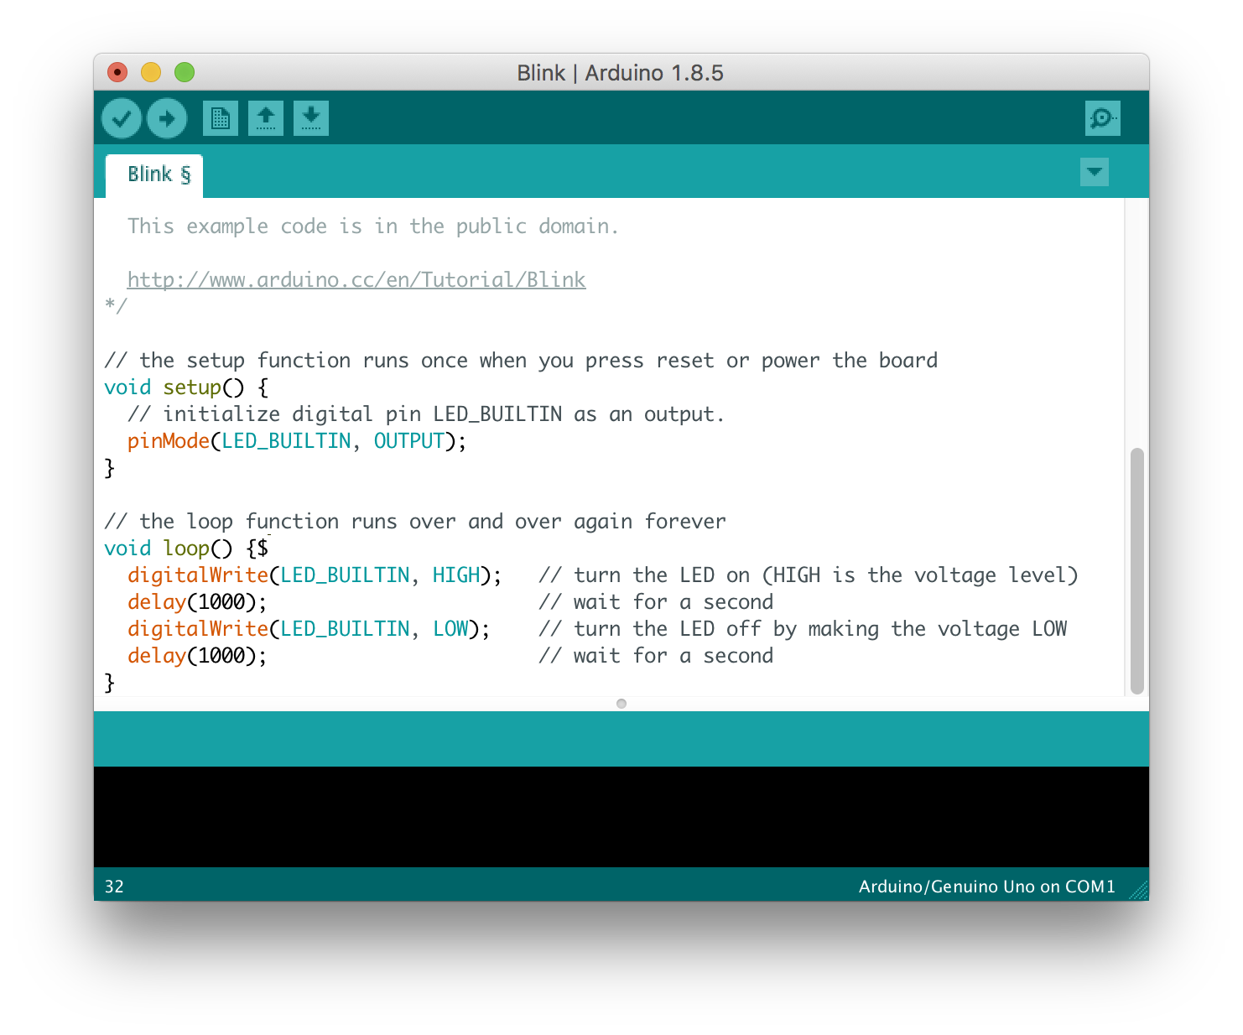
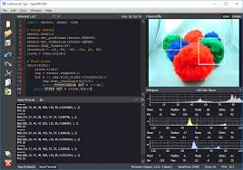

System Description
Arduino IDE
OpenMV IDE

Slide 12
Implementation Plan

Slide 13
Tasks
Task 1: Vehicle Structure Design
1.1: CAD of Structure
1.2: Construct Chassis
1.3: Implement wheel and tyre thread
1.4: Additional fram support(upper body)
1.5: Configure all body parts
Task 3: Application Design
3.1: App coding
3.2: GPS interfacing
3.3: Launch and testing
Task 2: Electrical Components
2.1: Assemble and implement Arduino
2.2: Interface PWM signal with motor
2.3: Servo assembly and implementation
2.4: Configure battery
2.5: ESC assemble
2.6: Configure GPS module
2.7 Apply component in vehicle structure

Slide 14
Tasks
Task 4: Computer Vision
4.1: Assemble OpenMV Cam H7
4.2: Configure image processing algorithm
4.3: Configure line/edge detection algorithm
4.4: Test accuracy and algorithm
4.5: Interface with arduino
4.6 Assemble camera on system
Task 5: Lidar Configuration
5.1: Lidar-Lite V3 hardware assembly
5.2: Implement Arduino IDE algorithm
5.3: Implement Lidar mapping
5.4: Interface with microcontroller
5.5 Assemble lidar on electric car
5.6 Accuracy Testing

Slide 15
Tasks
Task 6: Remote Control
6.1: Controller design
6.2: Interface with Arduino
6.3: Test functionality
Task 7: Testing, evaluation and enhancement
7.1: Test design requirements and functionality
7.2: Apply necessary changes
7.3 Repeat process

Slide 16
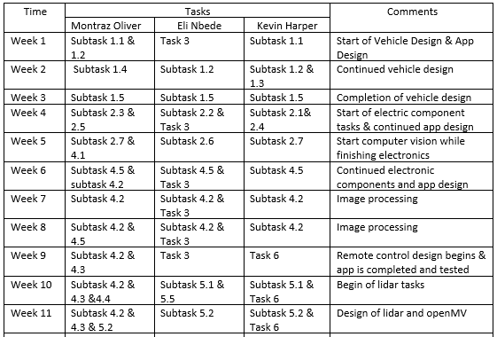

Slide 17
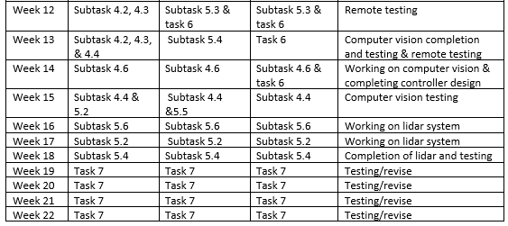

Slide 18


